Slide 1

HS Electives: Sociology Subject for High School
9th Grade
Culture & Social Control

Slide 2
Contents of This Template
Here’s what you’ll find in this Slidesgo template:
A slide structure based on a lesson, which you can easily adapt to your needs. For more info on how to edit the template, please visit Slidesgo School or read our FAQs.
An assortment of graphic resources that are suitable for use in the presentation can be found in the alternative resources slide.
A thanks slide, which you must keep so that proper credits for our design are given.
A resources slide, where you’ll find links to all the elements used in the template.
Instructions for use.
Final slides with:
The fonts and colors used in the template.
A selection of illustrations. You can also customize and animate them as you wish with the online editor. Visit Storyset to find more.
More infographic resources, whose size and color can be edited.
Sets of customizable icons of the following themes: general, business, avatar, creative process, education, help & support, medical, nature, performing arts, SEO & marketing, and teamwork.
You can delete this slide when you’re done editing the presentation.

Slide 3

Table of Contents
01
02
About This Topic
Examining Social Life
Here you can describe the topic of the section
Here you can describe the topic of the section
03
04
Social Control
Social Change
Here you can describe the topic of the section
Here you can describe the topic of the section

Slide 4
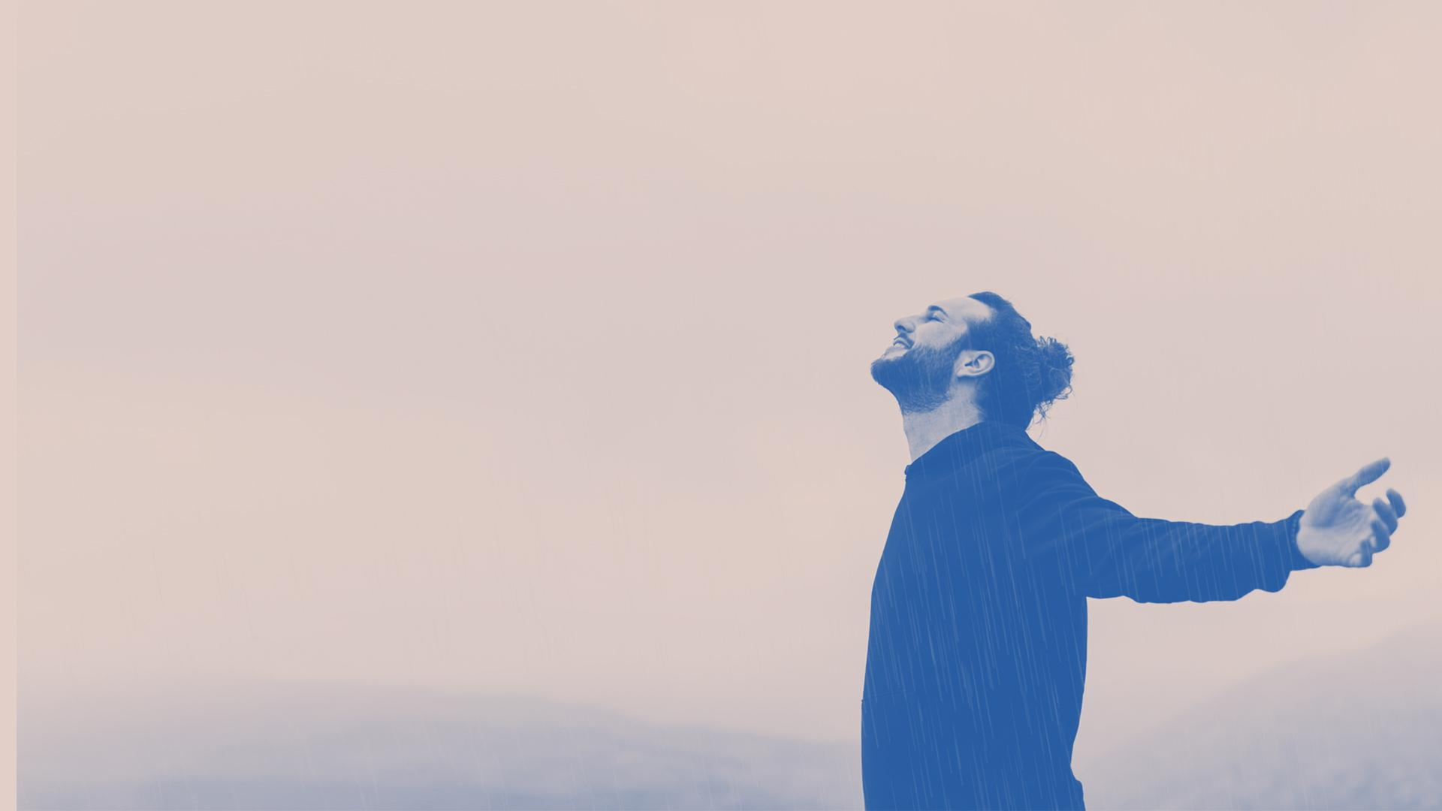
Whoa!
This can be the part of the presentation where you can introduce yourself, write your email…

Slide 5

“This is a quote, words full of wisdom that someone important said and can make the reader get inspired.”
—Someone Famous

Slide 6
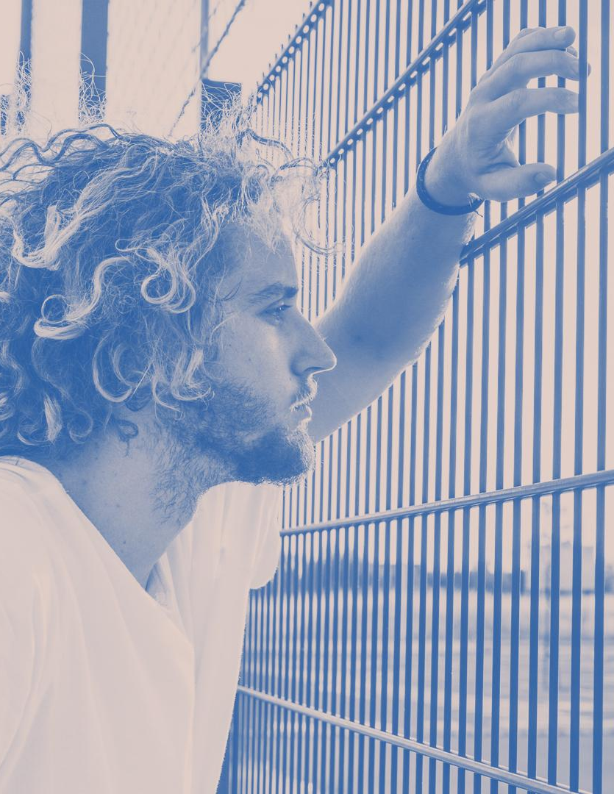
01
About This Topic
You can enter a subtitle if you need it

Slide 7

Social Control as a Classical Concept
Do you know what helps you make your point clear?
Lists like this one:
They’re simple
You can organize your ideas clearly
You’ll never forget to buy milk!
And the most important thing: the audience won’t miss the point of your presentation

Slide 8
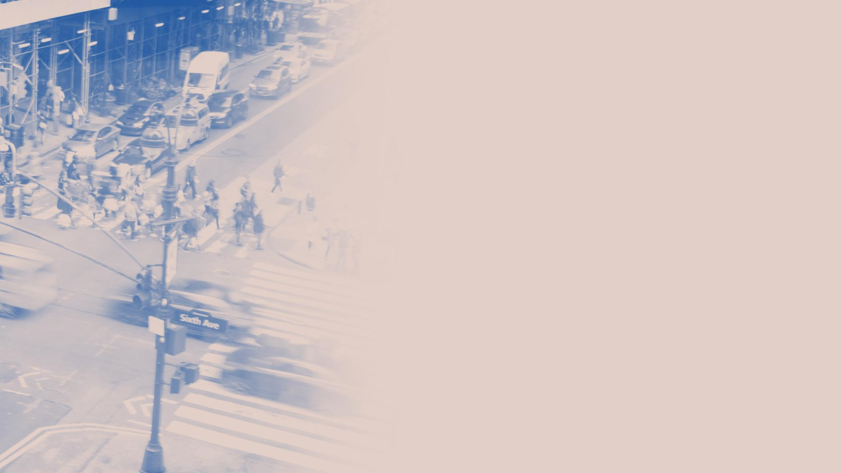
The Social Order
Mercury is the closest planet to the Sun and the smallest one in the Solar System—it’s only a bit larger than the Moon. The planet’s name has nothing to do with the liquid metal since it was named after the Roman messenger god, Mercury

Slide 9

What Is This Topic About?
Culture
Social Control
Despite being red, Mars is a cold place. It’s full of iron oxide dust, which gives the planet its reddish cast
Mercury is the closest planet to the Sun and the smallest in the Solar System. It’s only a bit larger than the Moon

Slide 10
Role of the Law in Social Control
Rules
Equity
Security
Saturn has several rings
Venus has a beautiful name
Despite being red, Mars is cold

Slide 11

02
Examining Social Life
You can enter a subtitle if you need it

Slide 12
Examining Social Life
Education
Police and Laws
Welfare State
Mercury is the closest planet to the Sun and the smallest of them all
Jupiter is a gas giant and the biggest planet in the Solar System
It’s a gas giant, composed mostly of hydrogen and helium

Slide 13
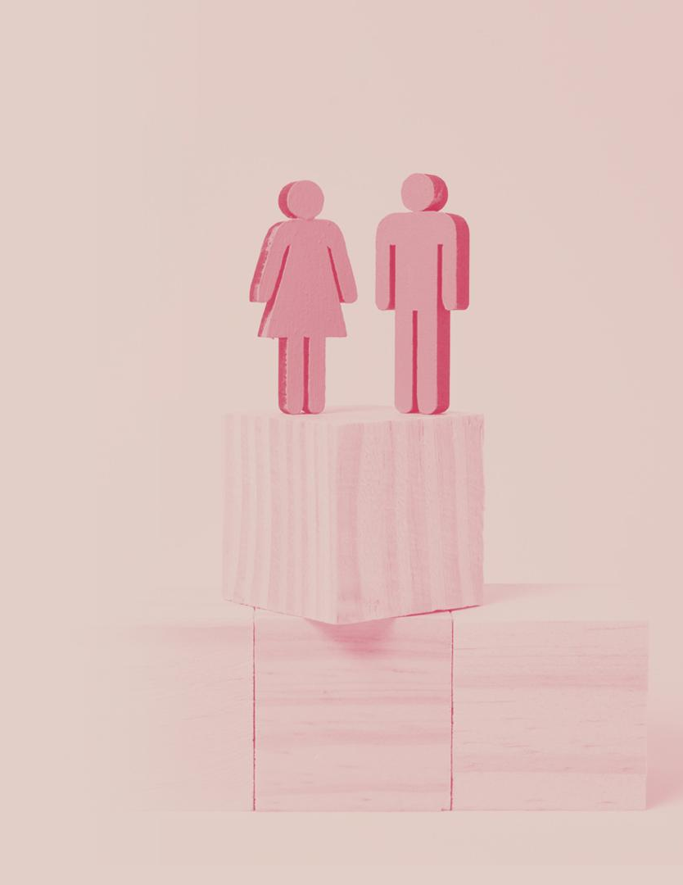
Social Values
Independence
Privacy
Saturn is a gas giant planet and without a solid surface
Jupiter is a gas giant and also the biggest planet of them all
Directness
Equality
Mars is a dusty, cold, desert world with a very thin atmosphere
Venus spins slowly in the opposite direction from most planets

Slide 14

A Picture Reinforces the Concept
Images reveal large amounts of data, so remember: use an image instead of a long text. Your audience will appreciate that

Slide 15
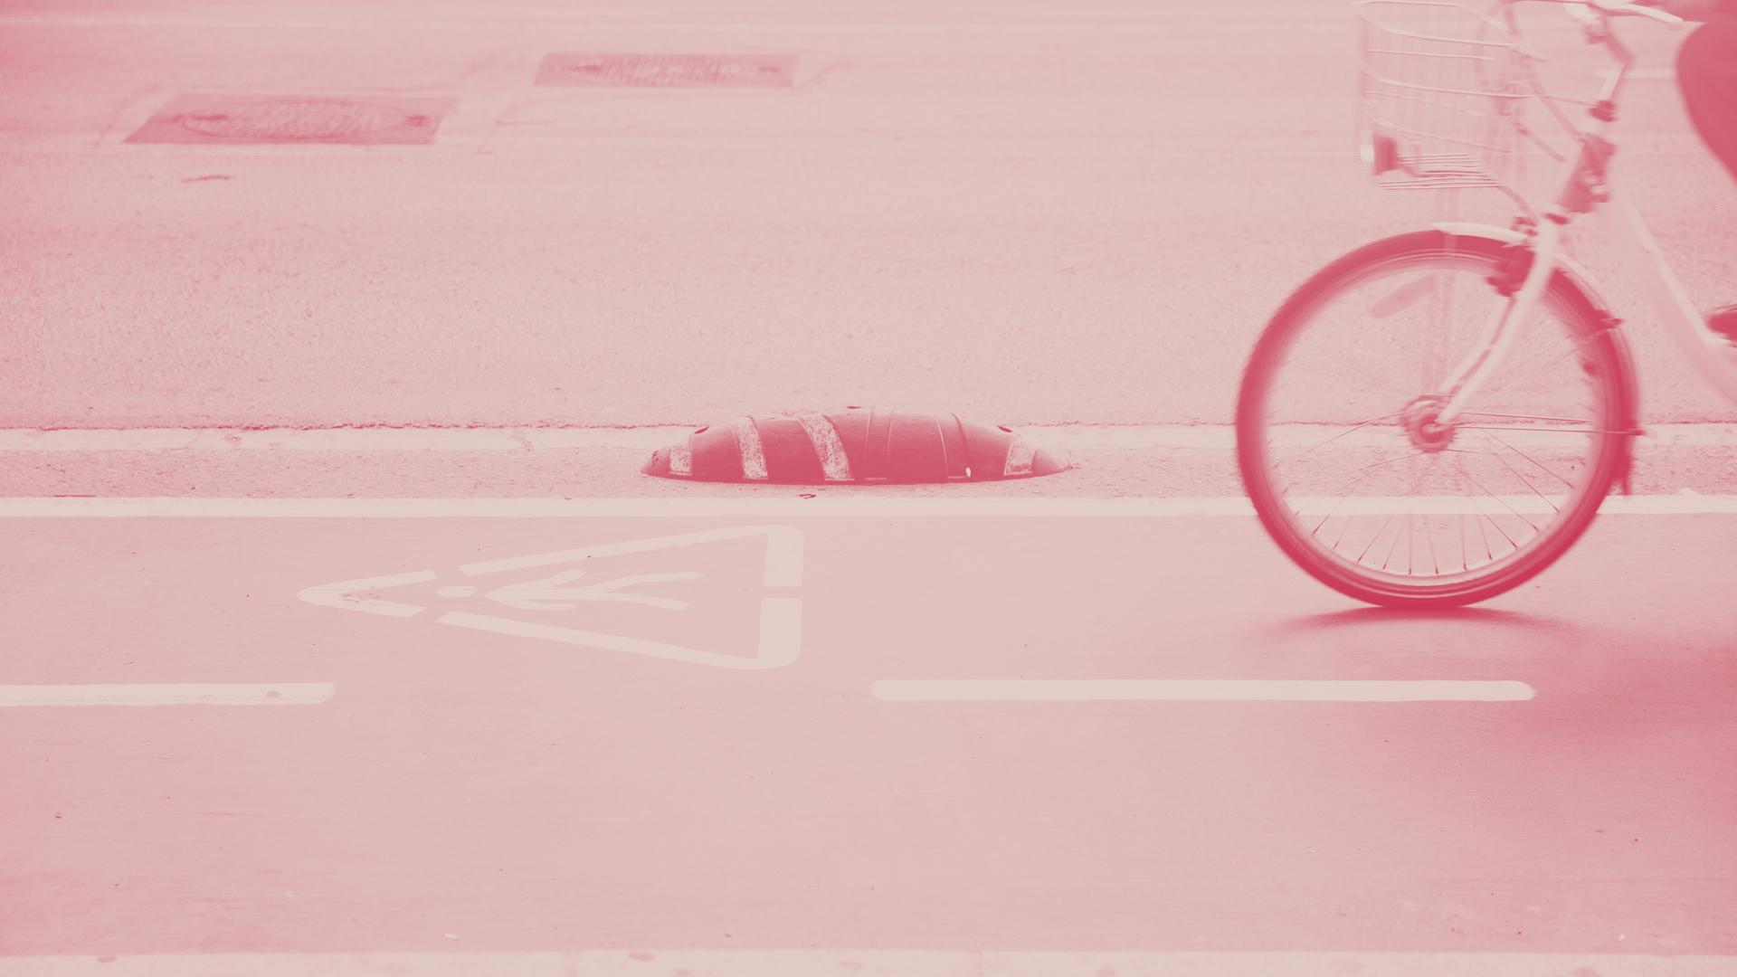
A Picture Is Worth a Thousand Words

Slide 16
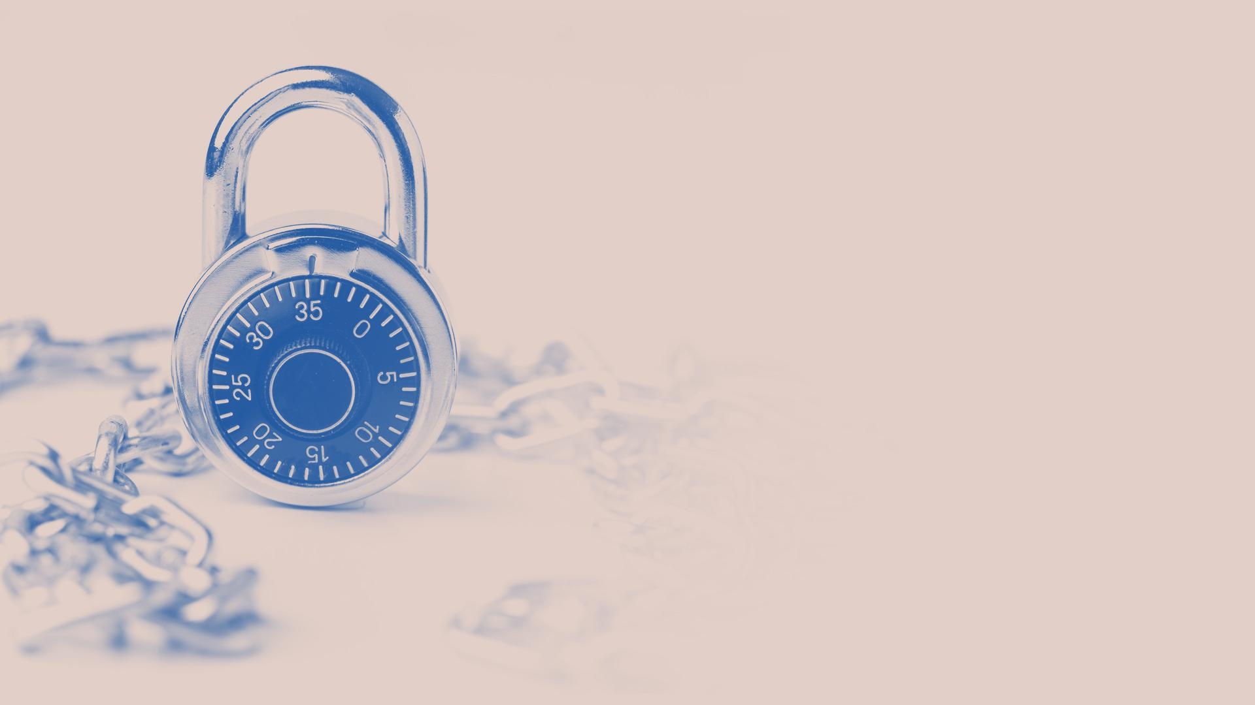
Awesome Words
Because keywords catch your audience’s attention

Slide 17
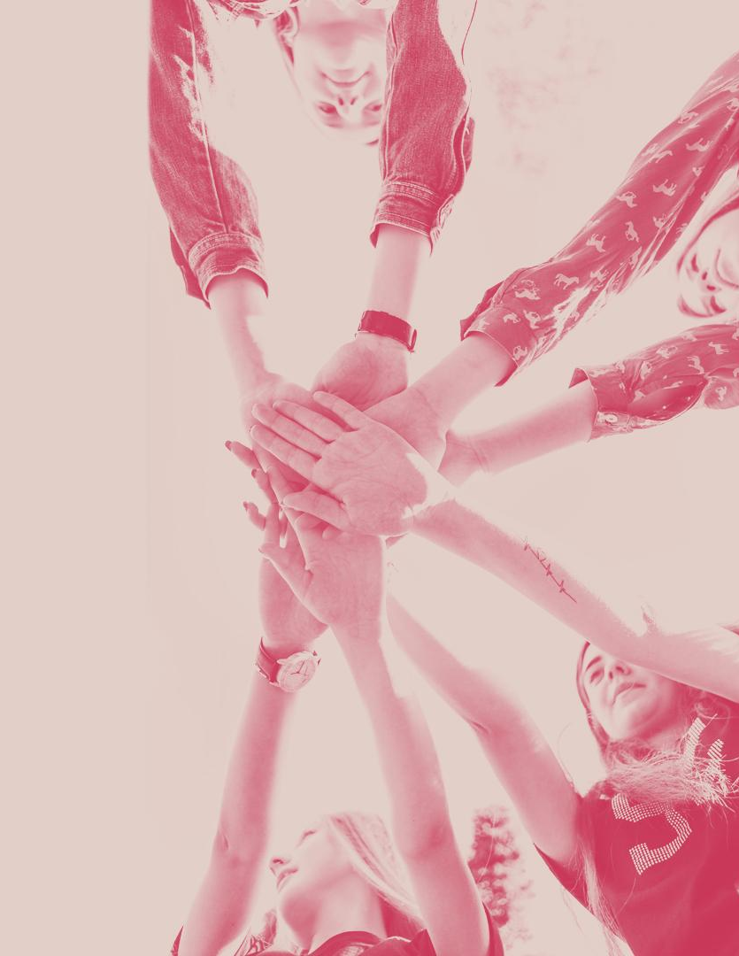
The Education System
Induces Sociability
Despite being red, Mars is a cold place. The planet is full of iron oxide dust
Cultural Training
Saturn is a gas giant, composed mostly of hydrogen and helium
Control Education
The reason why Neptune is blue is due to the presence of gas methane

Slide 18
Some Reasons
Artificial Demand
Influence
More & More
Neptune is the farthest planet from the Sun
Saturn is the ringed one and a gas giant
It’s the biggest planet in the Solar System
Always Newer
Acceptation
Publicity
Despite being red, Mars is a very cold place
Ceres was the first asteroid to be discovered
Sirius is the brightest star in the night sky

Slide 19
Some Percentages
35%
70%
55%
Neptune
Jupiter
Saturn
Neptune is the farthest planet from the Sun
It’s the biggest planet in the Solar System
Saturn is the ringed one and a gas giant

Slide 20
Infographic
Neptune
Venus
Neptune is the farthest planet from the Sun
It’s terribly hot, even hotter than Mercury
Jupiter
Mars
Mercury is the closest planet to the Sun
Despite being red, Mars is a very cold place

Slide 21
About Culture and Social Control
You can list here one fact about culture and social control
You can list here one fact about culture and social control
You can list here one fact about culture and social control
You can list here one fact about culture and social control
You can list here one fact about culture and social control

Slide 22
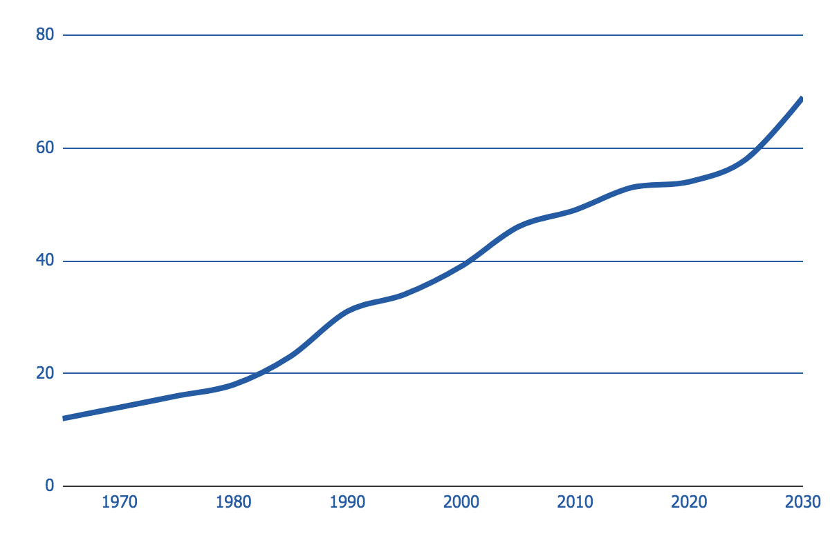
Evolution of Values Perception
+350%
Attitudes and Values
Neptune is the farthest planet from the Sun
Despite being red, Mars is a very cold place. It’s full of iron oxide dust, which gives the planet its reddish cast
Follow the link in the graph to modify its data and then paste the new one here. For more info, click here

Slide 23
Perception of Sociology
67%
33%
Sociology
Culture
Mercury is the closest planet to the Sun and the smallest of them all
Jupiter is a gas giant and the biggest planet in the Solar System

Slide 24
Map of Social Culture Differences
Venus
Saturn
Mars
Jupiter
Venus has a beautiful name
Saturn has several rings
Mars is a very cold place
Jupiter is the biggest planet

Slide 25
The American Value System
Privacy
Independence
Neptune is the farthest planet from the Sun
Saturn is the ringed one and a gas giant
Competition
Efficiency
Despite being red, Mars is a very cold place
Ceres was the first asteroid to be discovered

Slide 26
Nine Cultural Variation
Individualism
Power Distance
Uncertainty
Venus has a beautiful name
Saturn has several rings
Mars is a very cold place
Orientation to Time
Gender Equality
Assertiveness
The Moon is a nice satellite
It’s the smallest known planet
Jupiter is the biggest planet
Being vs. Doing
Humanity
Indulgence
Sirius is the brightest star
Earth is full of life and water
Neptune is the farthest planet

Slide 27
Timeline
Phase 2
Phase 4
Despite being red, Mars is a cold place
Saturn is a gas giant and has rings
Phase 1
Phase 3
Mercury is the closest planet to the Sun
Jupiter is the biggest planet of them all

Slide 28

Recommended Reading
About Culture and Control Social
AUTHOR (YEAR). Title of the publication. Publisher
AUTHOR (YEAR). Title of the publication. Publisher
AUTHOR (YEAR). Title of the publication. Publisher
AUTHOR (YEAR). Title of the publication. Publisher
AUTHOR (YEAR). Title of the publication. Publisher
AUTHOR (YEAR). Title of the publication. Publisher
AUTHOR (YEAR). Title of the publication. Publisher

Slide 29
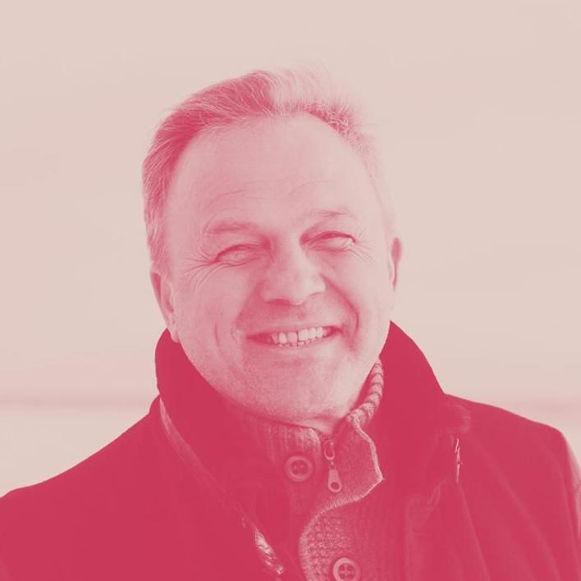
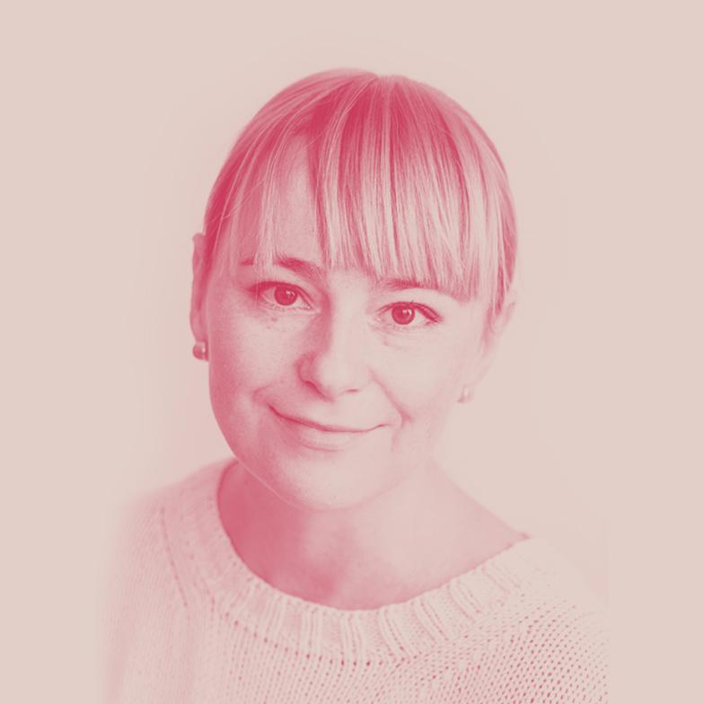
Our Team
Chris Williams
April Jameson
You can replace the image on the screen with your own work
You can replace the image on the screen with your own work

Slide 30
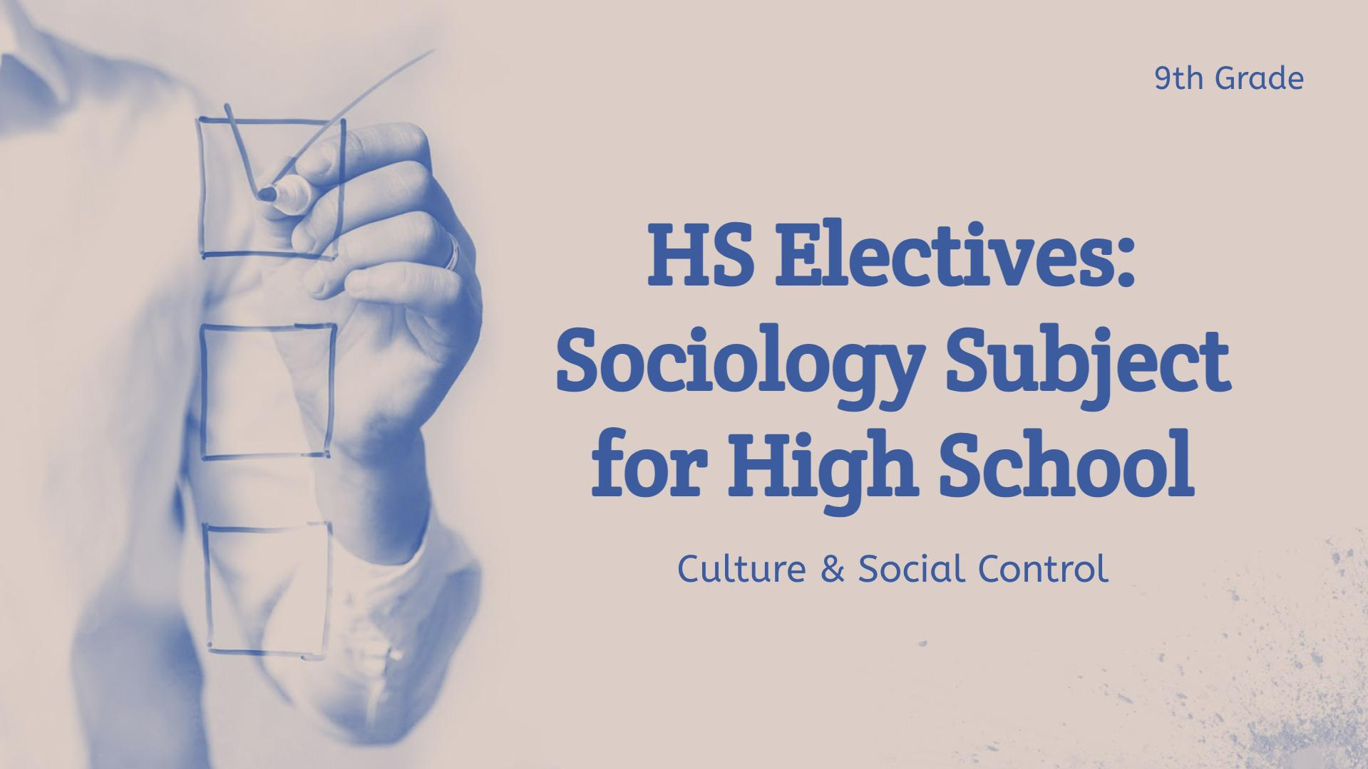
Visit Our Web
You can replace the image on the screen with your own work. Right click on it and choose "Replace image" so you can add yours

Slide 31
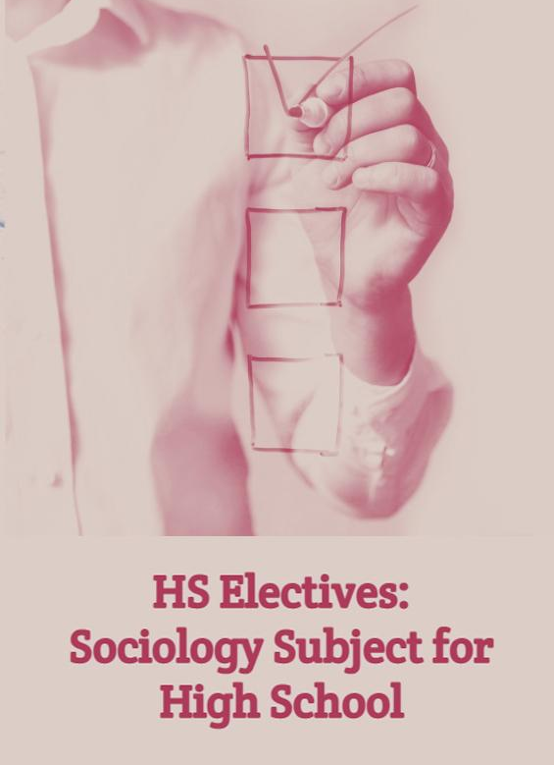
Learning Tablet Tools
You can replace the image on the screen with your own work. Right click on it and choose "Replace image" so you can add yours

Slide 32
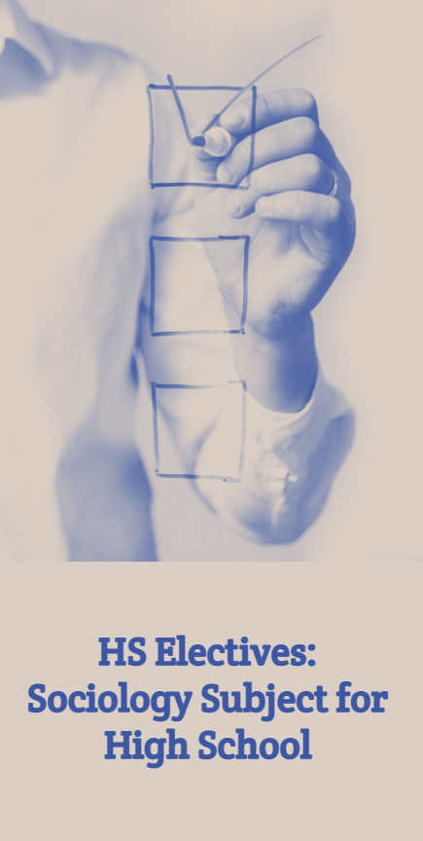
Stay Connected
You can replace the image on the screen with your own work. Right click on it and choose "Replace image" so you can add yours

Slide 33

Thanks!
Do you have any questions?
addyouremail@freepik.com
+91 620 421 838
yourcompany.com
Please, keep this slide for attribution

